Slide 1
Towards distributed Image Reconstruction

Slide 2
Who am I?
Jonas Schwammberger
Institute 4 Data Science @ FHNW
Masters degree in CS
If you have a question, just shout

Slide 3
What am I talking about
Distributing the Major Cycle (Gridding and Minor Cycle)
Proof-of-concept implememtations.

Slide 4
Major/Minor Cycle

Slide 5
Major / Minor Cycle
~ 4 GB
32k * 32k image
< 1%
Non-Zero Pixels
1000+ GB

Slide 6
Distribute Gridding!

Slide 7
But what about the Minor Cycle?
Deconvolution may become the most time consuming step
Deconvolution is done only on one node
All other nodes idle during deconvolution
We can use the idling nodes for deconvolution

Slide 8
Minor Cycle distribution can exploit the data properties
How large is the PSF
How large is the grid vs. the calibrated Visibilities
How sparse is the model image
…
Test on a real world MeerKAT observation

Slide 9
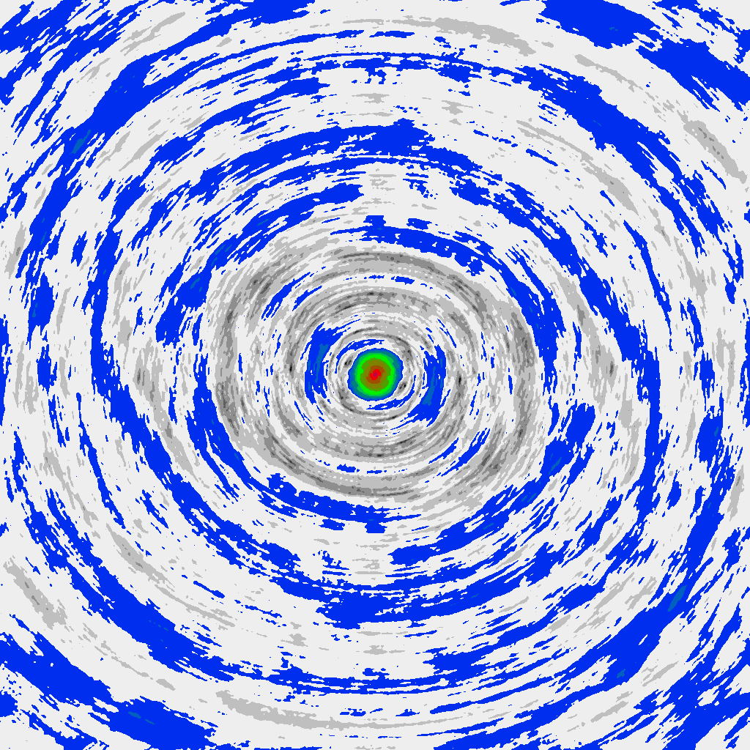
The problem of distributed deconvolution

Slide 10
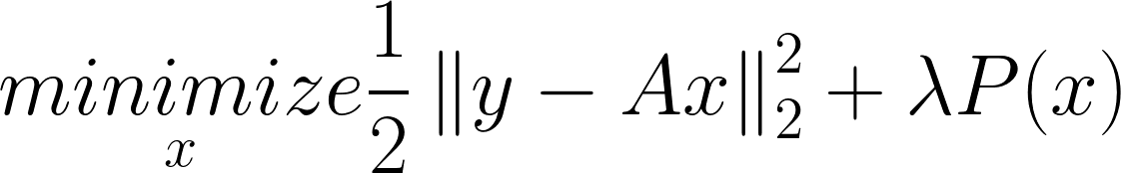
Compressed Sensing based deconvolution
A represents the convolution
P() represents the prior knowledge about our image
Optimization algorithm needed, Gradient Descent, ADMM…
CLEAN can be seen as a Compressed Sensing based deconvolution

Slide 11
Compressed Sensing based deconvolution
Prior P() → ElasticNet
Optimization Algorithm → Coordinate Descent

Slide 12
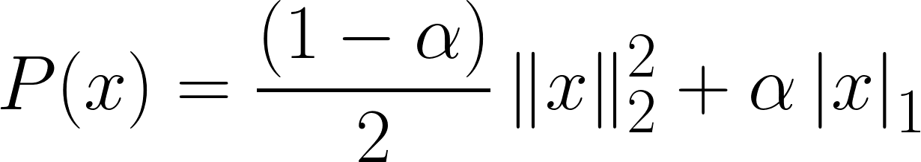


ElasticNet Prior
Mixture between L1 and L2 Norm

Slide 13
Coordinate Descent algorithm
Algorithm:
Minimizes one pixel at a time
Iterate over pixels (with some strategy) until convergence
Effective for high-dimensional problems
Parallel/Distributed/GPU variants

Slide 15
Distributed Minor Cycle

Slide 16
Preliminary Results
Implemented in C# .netcore
1 Node vs 4 Nodes
Speedup of a factor 3.2

Slide 17
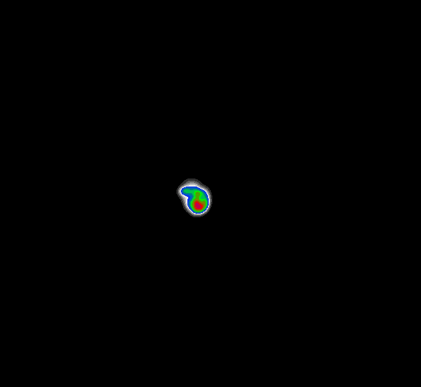

Preliminary Results

Slide 18
Limitations
Proof of concept implementation
Data volume not (yet) representative
Minor Cycle is latency limited

Slide 19
Next Steps
GPU Acceleration for Coordinate Descent
Test on Azure Cloud
MORE DATA

